Slide 1
Understanding the Perimeter Buffer Area
Biosecurity Training for Individuals Working on the Poultry Operation
Notes:
October 2018
Everyone entering the poultry operation plays an essential role in protecting the health of the poultry on a poultry site. By following specific biosecurity steps, employees can minimize the risk of bringing avian influenza or other diseases to the site. One of the most important biosecurity concepts for you to understand is called the Perimeter Buffer Area.

Slide 2
Learning Goals
Explain how to identify the Perimeter Buffer Area (PBA) and what its purpose is
Describe how to respect the PBA
Explain biosecurity measures to be taken when entering the PBA
Notes:
By the end of this training, you should be able to [CLICK] explain how to identify the Perimeter Buffer Area, or PBA; [CLICK] describe how to respect the PBA; and [CLICK] explain the biosecurity measures that need to be taken when entering the PBA.

Slide 3
Perimeter Buffer Area (PBA)
Outer control boundary around the buildings and poultry raising area
Purpose to reduce contamination, protect birds
Control entry of vehicles, equipment, people → reduce risk of disease introduction
Notes:
The Perimeter Buffer Area, or PBA, is [CLICK] an outer boundary set up around the perimeter of all of the buildings and other structures that are involved in poultry raising. [CLICK] The purpose of having a PBA on the poultry site is to reduce the potential for contamination of the area around the buildings. [CLICK] By controlling entry of vehicles, equipment and people into the PBA, the risk of introducing disease into the poultry areas will be reduced.

Slide 4
“First Line of Defense”
Notes:
The PBA is sometimes called the “first line of defense” for protecting the birds housed within the perimeter. It can be helpful to think of the PBA as [CLICK] a moat around a castle. The drawbridge is the access point, controlled by the operation. The operation decides when to lower the drawbridge and let in a vehicle, person, or other item after appropriate biosecurity measures have been followed. The walls of the castle are the “last line of defense,” which we call the Line of Separation. The Line of Separation is covered in another video.

Slide 5
Identifying the PBA
Read the Biosecurity Plan
Look for barriers on the site,
signage
Ask the Biosecurity Coordinator
Notes:
The PBA can vary from site to site as each farm is different. There are multiple ways that the PBA can be identified on the site you are working on. The best way to determine where the PBA is located is by [CLICK] reading the site-specific biosecurity plan, which may include a labeled map of the site. The PBA may be delineated by [CLICK] boundaries such as a road or driveway, natural or artificial barriers, signage, [CLICK] or other methods that clearly identify the boundary, like a fence, flags or rope. Finally, you may [CLICK] ask the Biosecurity Coordinator for details on the location of the PBA, since he or she has played an important role in deciding where the PBA is located.

Slide 6
Example PBA
Notes:
This example site demonstrates the concept of the Perimeter Buffer Area (PBA). In this example, access to the site is restricted by an entry gate leading to a controlled access driveway, as can be seen in the upper left portion of the graphic. Employee and visitor parking remains outside the gate. The PBA, which is shaded in light blue, surrounds the employee building and poultry houses. Personnel enter the PBA through the Employee Building where they change into clean clothes or coveralls and footwear. Sometimes, certain tasks can be completed by staying just outside of the PBA. An example of this is shown in the dead bird collection container that can be seen in the upper right portion of the graphic. A dead bird collection container straddling the PBA means that personnel who are inside of the PBA can move dead birds to the container in the direction shown by the blue arrows, and personnel who are outside of the PBA can remove the dead birds as necessary to take them off of the site. The other things depicted in this graphic, such as the Line of Separation and Danish Entry System are covered in another video.

Slide 7
Example PBA
Notes:
Another example of a PBA is shown in this aerial photo of a poultry site. In this example, the perimeter buffer area is outlined in light blue and surrounds all of the buildings on this site. The designated parking area is outside of the PBA. As in the previous example, the carcass disposal and pickup location straddles the PBA in the bottom right corner of the photo.

Slide 8
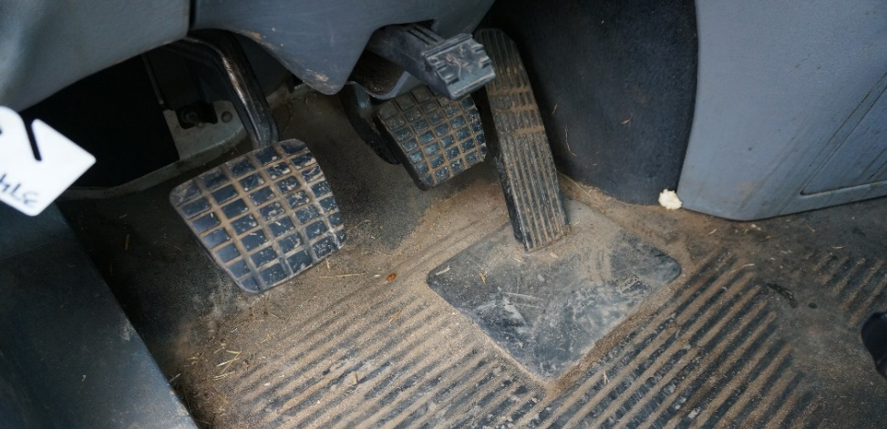
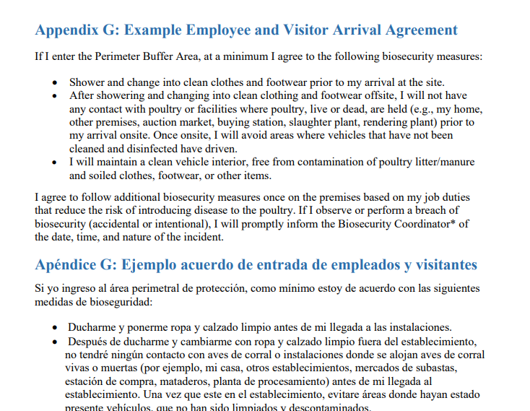
Respecting the PBA- Personnel
Know if job duties require entry
Prior to arrival
Showered
Clean clothing, footwear
Personal items left home
Clean vehicle interior
Arrival agreement
Entry logbook
Notes:
Before arriving at the site, [CLICK] you should know whether or not your job duties will require you to enter the PBA. [CLICK] If so, you should arrive at the site [CLICK] having showered and [CLICK] wearing clean clothing and footwear since last contacting poultry. [CLICK] You should also leave unnecessary personal items, like jewelry, at home. [CLICK] The vehicle that you arrive in should be clean and free of all poultry manure and litter and other soiled items. Before entering the site, you may need to [CLICK] have a signed agreement on file indicating that you understand and will follow specific biosecurity protocols. [CLICK] You should determine if and where the site keeps their entry logbook, and should sign it prior to entering the PBA.

Slide 9
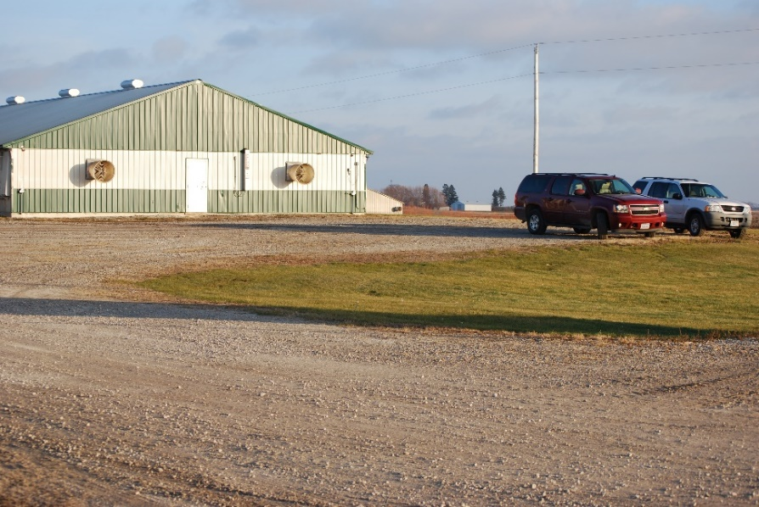
Respecting the PBA- Vehicles and Equipment
Parking Area
For vehicles not entering site
Outside of PBA
Deliveries, supplies
Outside of PBA
Others proceed to Cleaning & Disinfection (C&D) Station
Pam Zaabel, ISU
Notes:
[CLICK] Vehicles that will not be entering the site, including most employee and visitor vehicles, should be parked [CLICK] outside the PBA in an area designated for this purpose. The parking area may be identified by looking for a [CLICK] sign, like the one shown here, or the location of the parking area may be labeled on a map of the site, or may be described in the site’s biosecurity plan. [CLICK] If you are delivering supplies, [CLICK] including things like feed, to the poultry site, there may be a specific route and location for you to use, [CLICK] so that you do not have to enter the PBA. Sometimes, the delivery location may be off-site. There are many other items that may need to cross the Perimeter Buffer Area, and this should be done in a biosecure manner. You should only bring personal items or food into the PBA or across the LOS if they are necessary to perform job duties that must take place within the operation. Items should be cleaned and disinfected, or C&Ded, before crossing, so any items that cannot be C&D should be left at home or kept in a location outside of the PBA. Certain items, such as electronics, may not be able to be effectively cleaned and disinfected and should be placed in a sealed plastic bag or container before entering the site. [CLICK] If you need to enter the PBA within your vehicle, your vehicle will need to be cleaned and disinfected. Usually, this will occur at a cleaning and disinfection, or C&D, station on the site.

Slide 10
Respecting the PBA- Vehicles and Equipment
Certain movements may be different
C&D before arrival at site
Poultry transport
Inclement weather
Shared equipment
Etc.
See plan, Biosecurity Coordinator
Entry logbook
Notes:
[CLICK] Sometimes, it may not be clear whether you should enter the PBA in your vehicle or not, or whether or not your vehicle can be cleaned and disinfected. For example, you may wonder [CLICK] if your vehicle was already cleaned and disinfected– using chemical disinfectants or heat– before arrival at the site, if it needs to be C&Ded again. Other things may make driving through a cleaning and disinfection station difficult or impossible, for example [CLICK] having an open truck with live birds, or [CLICK] arriving during inclement weather such as freezing temperatures or rain. In yet other cases, you may question whether equipment should enter the site at all, [CLICK] for example, a piece of equipment that is shared with another poultry site. Because each site is different, the procedures that you need to follow in each of these situations, and [CLICK] others that you may encounter, will [CLICK] depend on the site’s biosecurity plan, and the direction of the Biosecurity Coordinator.
[CLICK] Remember, if you are entering the site within a vehicle, you may still need to sign an entry logbook.

Slide 11
Entering the PBA- Personnel
Proceed directly to PBA Access Point
Avoid potential contamination
Follow biosecurity steps at PBA Access Point
Steps may vary for
Site-dedicated personnel
Non-farm personnel
Recent poultry contact
Follow steps while exiting vehicle
Danelle Bickett-Weddle, ISU
Notes:
After parking in the designated area, [CLICK] walk directly to the PBA Access Point for people entry. [CLICK] Avoid walking through areas where potentially contaminated vehicles have driven, and don’t walk through puddles on the site, since these puddles may contain droppings from wild birds or waterfowl that might be carrying avian influenza virus. [CLICK] Once you arrive at the PBA Access Point, follow the biosecurity steps required. These steps will vary by site but may include changing into site-dedicated rubber boots or putting on disposable boots, and washing your hands, applying hand sanitizer, or wearing gloves. [CLICK] Your procedures may also vary depending on if you [CLICK] are a site-dedicated employee, [CLICK] if you are non-farm personnel, or [CLICK] if you have had recent contact with poultry. If you have crossed the PBA in a vehicle and then will be getting out of the vehicle once within the PBA, [CLICK] these biosecurity steps should be performed while you are exiting the vehicle, like shown in this photo, to avoid bringing contamination onto the poultry site.

Slide 12
Entering the PBA in a Vehicle
Only done through a PBA Access Point
Cleaning and disinfection likely
See biosecurity plan, map
C&D station operated by trained personnel
Keep windows closed
Danelle Bickett-Weddle, ISU
Notes:
Equipment used on poultry production sites can serve as a means for disease spread. If you are entering the PBA within a vehicle, [CLICK] you must only do so through a PBA Access Point meant for vehicles and equipment. Here, [CLICK] your vehicle will likely need to go through a cleaning and disinfection, or C&D, station, to reduce the risk of disease being brought onto the site. [CLICK] You should be able to determine where the C&D station is by looking at the site’s biosecurity plan, which may include a map, or by asking the Biosecurity Coordinator. [CLICK] You should stay in your vehicle and let trained, site-dedicated individuals clean and disinfect your vehicle, because these people have been trained to operate the C&D station, perform C&D effectively, and control runoff, and should be wearing appropriate personal protective equipment for the disinfectant used. [CLICK] While being C&D, you should keep the windows of your vehicles closed to prevent disinfectant from contacting your skin or eyes, as well as to avoid transporting insects onto or off of the poultry site.

Slide 13
Poultry Movement
Should meet certain conditions
Source follows certain biosecurity practices
Compliance with NPIP
Vehicle C&D
May vary during periods of heightened risk
Lara Durben, MN Turkey Growers Association
Notes:
Maintaining biosecurity during movement of birds onto and off of the operation is critical. Any poultry that come onto the site [CLICK] should meet all of the conditions that your operation, as the operation receiving the birds, requires. For example, this might include [CLICK] verifying that the source site follows certain biosecurity practices, [CLICK] confirming that the site is in compliance with NPIP guidelines, which might include negative test results for influenza virus, or [CLICK] ensuring that the vehicle in which the birds arrive was effectively cleaned and disinfected before being loaded with that group of birds. [CLICK] Sometimes, during periods of heightened risk, such as during an avian influenza outbreak, there may be additional things that need to be verified before poultry should be allowed onto the operation. Be sure to check with the biosecurity coordinator, to make sure that you are clear on the type of poultry movements that are allowed.

Slide 14
Poultry Loading/Unloading
Done through a PBA Access Point meant for bird movement
Vehicles, personnel, equipment involved follow biosecure entry procedure
Maintain directional flow, do not exit and then re-enter
Special procedures may be needed
Notes:
Poultry loading and unloading [CLICK] should be done through a PBA Access Point meant for that purpose. [CLICK] Vehicles involved in poultry loading or unloading should be C&D when entering the PBA, unless they are carrying live birds. All personnel transferring birds into the PBA should follow the biosecure entry procedure required for their job duties. [CLICK] When moving poultry, you should maintain directional flow of birds, and people or birds which have exited the PBA should not go back into it without first following the biosecurity steps required for entry into the PBA. Sometimes, help from an extra person may be needed to make sure all biosecurity steps are followed. All movements of birds, cages, dollies, and other containers should also only occur through designated PBA access points.
[CLICK] Sometimes, poultry movement may require special procedures that are different from how things normally enter the PBA. This might include things like using a staging vehicle to transfer poultry over the biosecurity lines on the site, or even temporarily modifying where the PBA is during loading or unloading. It is a good idea to check with the biosecurity coordinator, and section on replacement poultry in the site’s biosecurity plan, before loading or unloading birds onto or off of the site.

Slide 15
Biosecure Exit Procedure
Remove site-dedicated or disposable clothing, boots
C&D footwear, wash hands
Soiled clothing sealed in bag/tote or left on operation
Danelle Bickett-Weddle, ISU
Notes:
It is also important to prevent visible contamination on clothing, footwear, and exposed skin from leaving the operation and being transferred to other locations with susceptible poultry. In most cases, the Biosecure Entry Procedure is followed in reverse when leaving the PBA. This usually involves [CLICK] removing any site-dedicated or disposable clothing or footwear, [CLICK] cleaning and disinfecting footwear that is leaving the site, and washing your hands. Additional steps may also be required. [CLICK] Any soiled clothing can be left on the operation to be laundered or disposed of. If you need to bring it with you, store it in a garbage bag or tote until it can be laundered.

Slide 16
Items leaving the PBA
Mortalities
Step-wise removal for container at edge of PBA
Report if needed
Manure and litter
SOPs
May involve modified PBA
Site-dedicated equipment
Notes:
Like when people perform a biosecure exit procedure, it is a good practice to maintain biosecurity when other items leave the Perimeter Buffer Area. Two examples of product leaving the PBA are [CLICK] mortalities, and [CLICK] manure or litter.
[CLICK] Mortalities are sometimes collected for a period of time within the PBA, for example in a closed, leak-proof container, and then removed from the operation at a later time. Ideally, this will be at the edge of the PBA, so that dead birds can be deposited into it by people within the PBA, and removed by people who are outside of the PBA. Likewise, the truck or other equipment that collects and transports the dead birds should remain outside of the PBA. If you are involved in mortality management or disposal, and [CLICK] notice that there seems to be an unexpected increase in sick or dying birds, remember that it is important to tell someone, in case it is an undetected disease outbreak.
Similar biosecurity precautions should be taken for poultry manure and litter that is leaving the site. [CLICK] For some procedures, there may be Standard Operating Procedures, or SOPs, that you can follow. Like for poultry movement, movement of litter and manure [CLICK] may require special procedures that are different from how things normally enter the PBA, potentially including a modified PBA.
[CLICK] If a site-dedicated piece of equipment leaves the PBA, it should only re-enter after following a biosecure entry procedure at a designated PBA access point.

Slide 17
Congratulations!
Complete the lessons:
Understanding the Perimeter Buffer Area
Do Not Bring Disease to the Poultry Site
Understanding the Line of Separation
Then:
Review the parts of the written site-specific biosecurity plan that apply to your responsibilities
Document your training
Notes:
Congratulations! You, someone who will be working on the poultry operation, have [CLICK] completed the lesson on “Understanding the Perimeter Buffer Area”. If you have not already, watching the training video on [CLICK] “Do Not Bring Disease to the Poultry Site” can help you understand how to avoid bringing disease to the site. You can also learn about how to prevent the spread of disease once you are on the site, by watching the training video called [CLICK] “Understanding the Line of Separation.” The operation’s written site-specific biosecurity plan may have additional protocols for you to follow, so be sure to [CLICK] review the parts of the written plan that apply to your responsibilities, and contact the Biosecurity Coordinator with any questions you may have. [CLICK] Be sure to document all of your training.

Slide 18
Notes:
Development of poultry biosecurity training materials was funded by USDA. [CLICK] This video was written and produced by the Center for Food Security and Public Health at Iowa State University, College of Veterinary Medicine.

