Slide 1
Do Not Bring Disease to the Poultry Site
Biosecurity Training for Individuals Working on the Poultry Operation
Notes:
October 2018
Everyone entering the poultry operation plays an essential role in protecting the health of the poultry on a poultry site. By following specific biosecurity steps, employees can minimize the risk of bringing avian influenza or other diseases to the site.

Slide 2
Learning Goals
Identify situations that may allow poultry diseases to spread
Describe ways to minimize chances for disease to be introduced to a production site
Identify people to contact for questions or concerns related to biosecurity on the production site
Notes:
As an individual working on the poultry operation, you have a very important role in maintaining biosecurity. Preventing the introduction and spread of disease, such as avian influenza, or AI, onto or off of the operation depends greatly on your awareness and practice of the biosecurity measures described in the site’s biosecurity plan. By the end of this training, you should be able to [CLICK] identify situations that may allow poultry diseases, especially avian influenza, to spread; [CLICK] describe ways to minimize chances for disease to be introduced to a production site; and [CLICK] know who to contact for questions or concerns related to biosecurity on the production site.

Slide 3
Disease Spread: Saliva
Notes:
Before learning specific ways to prevent diseases from entering your poultry site, it is important to understand the multiple ways that diseases such as avian influenza can be spread. Avian influenza can be spread [CLICK] through saliva,

Slide 4
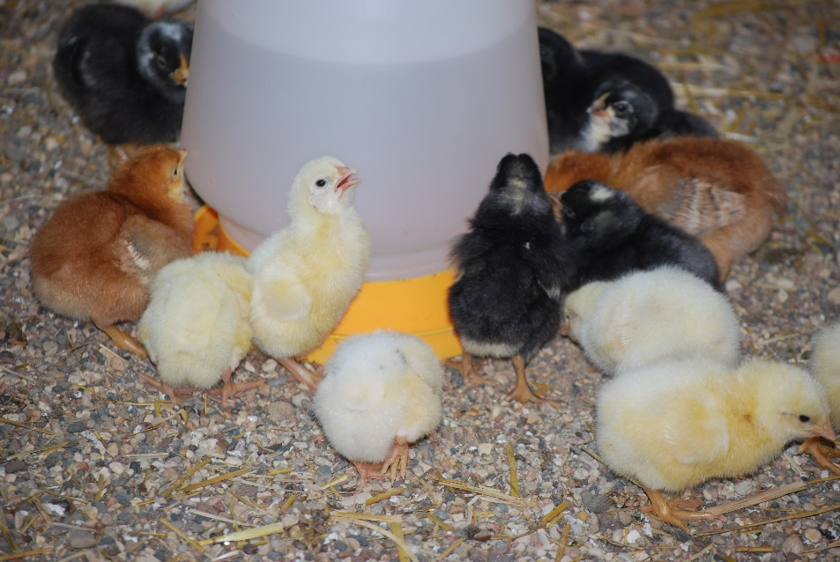
Disease Spread: Saliva
Andrew Kingsbury, ISU
Pam Zaabel, ISU
Notes:
when birds eat, drink, or peck at contaminated objects.

Slide 5
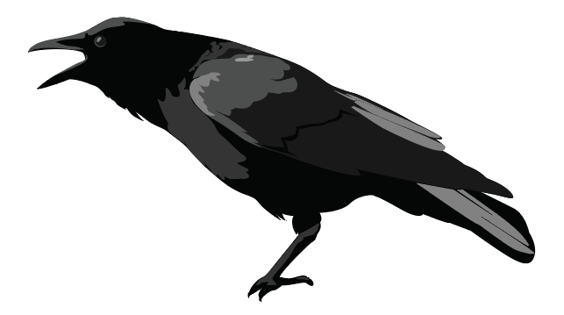
Disease Spread: Manure, Litter
Notes:
Avian influenza virus has been shown to survive in [CLICK] poultry manure and litter for long periods of time, especially in cold weather. It can spread to poultry from contact with the feces of [CLICK] wild birds or waterfowl.

Slide 6
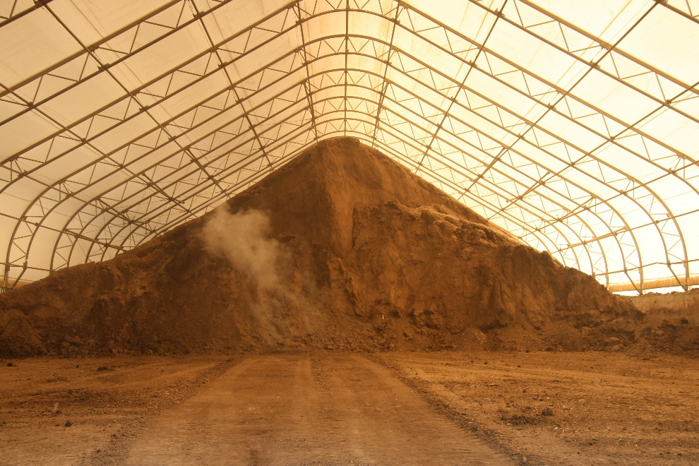
Disease Spread: Manure, Litter
Andrew Kingsbury, ISU
Andrew Kingsbury, ISU
Notes:
Disease spread could occur through vehicles, equipment, and personnel involved in manure removal, transport, and storage. It may be necessary to follow special instructions for how the biosecurity lines on the operation should be crossed during manure removal and transport activities.

Slide 7
Disease Spread: Breath
Notes:
AI and other diseases can also be spread through the air when infected animals [CLICK] breathe out,

Slide 8
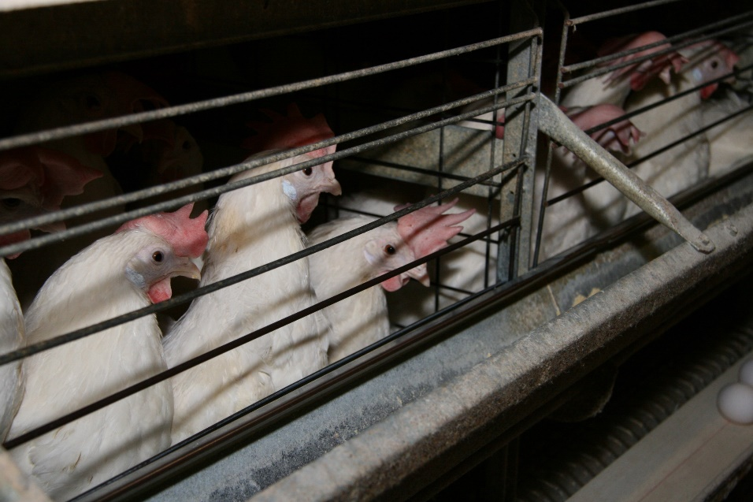
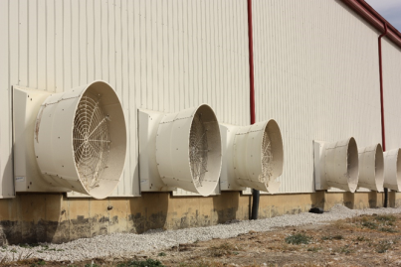
Disease Spread: Air
Andrew Kingsbury, ISU
Andrew Kingsbury, ISU
Notes:
and can be spread through the air to birds in the same barn [CLICK] , between birds in different barns or even [CLICK] between birds on different nearby sites.

Slide 9
Disease Spread: Fomites
Notes:
If items used around poultry with disease aren’t cleaned between uses, the next group of poultry could get the disease. These items include vehicles, [CLICK] equipment, clothing, footwear, [CLICK] and more, and are called fomites. In addition, pests like rodents, [CLICK] insects, [CLICK] and other domestic or wild animals may be contaminated with virus on their hair or feet and may act like a fomite to spread disease to the site or may contaminate poultry feed. Other fomites could include anything used for the handling, care, treatment, or euthanasia of poultry, or any other items that may have contacted infected poultry or entered poultry houses, such as cages or egg handling equipment, that have not been effectively cleaned and disinfected.

Slide 10
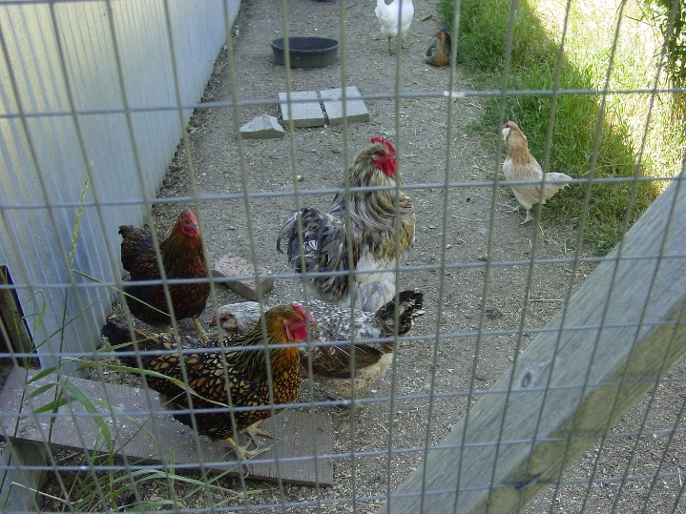
Ways You Could Become Contaminated
Birds at home
Living with people who work at other production sites
Duck, turkey, goose, or pheasant hunting
Stopping at sites previously visited by contaminated individuals or vehicles
Danelle Bickett-Weddle, ISU
Renee Viehmann, licensed under Creative Commons
Notes:
Next, we will cover specific ways that you and your clothing or footwear could become contaminated with virus, or other disease-causing organisms, when you are off-site. Some ways that you may become contaminated include [CLICK] having birds, including poultry, and waterfowl, at home; [CLICK] living with people who work at other poultry production sites; [CLICK] hunting or contact with ducks, turkeys, geese, or pheasants; and [CLICK] stopping at sites previously visited by contaminated individuals or vehicles, such as gas stations where rendering truck drivers or livestock haulers stopped.

Slide 11
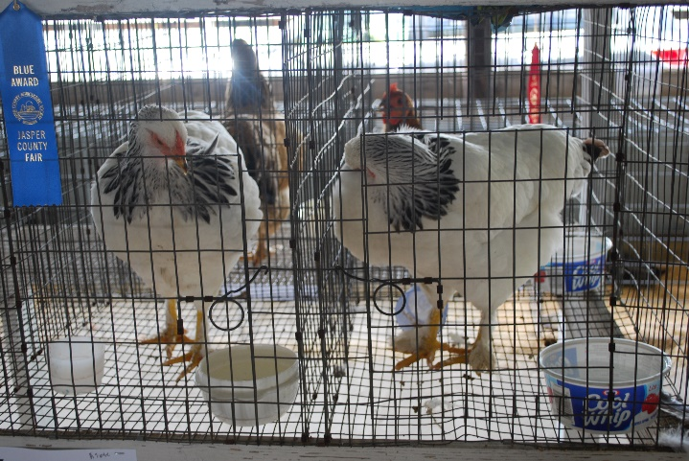
Ways You Could Become Contaminated (cont’d)
Working at or visiting
Exhibitions
Auction markets
Processing plants
Rendering facilities
Diagnostic labs
Sales
Swap meets
Petting zoos
Etc.
Pam Zaabel, ISU
iStock
Notes:
Other examples of places where you might become contaminated include working at or visiting [CLICK] exhibitions, [CLICK] auction markets, [CLICK] processing plants, [CLICK] rendering facilities, [CLICK] diagnostic labs, [CLICK] sales, [CLICK] swap meets, or [CLICK] petting zoos.

Slide 12
Access to the Operation
Limit to essential individuals
May require change in practices, planning
Discuss with Biosecurity Coordinator
Reneé Dewell, ISU
Notes:
Next, we will cover ways that you can help prevent diseases from coming onto the operation where you work. Access should be limited to [CLICK] individuals who are essential to the operation of the site. If you must enter the operation in your vehicle, you should remain in their cab unless your job duties require you to exit the vehicle. [CLICK] This may require some advance planning. [CLICK] Talk with the Biosecurity Coordinator to determine if there is a way to accomplish your duties on the operation while minimizing your need to enter the site. More information on specific biosecurity measures is provided throughout this presentation.

Slide 13
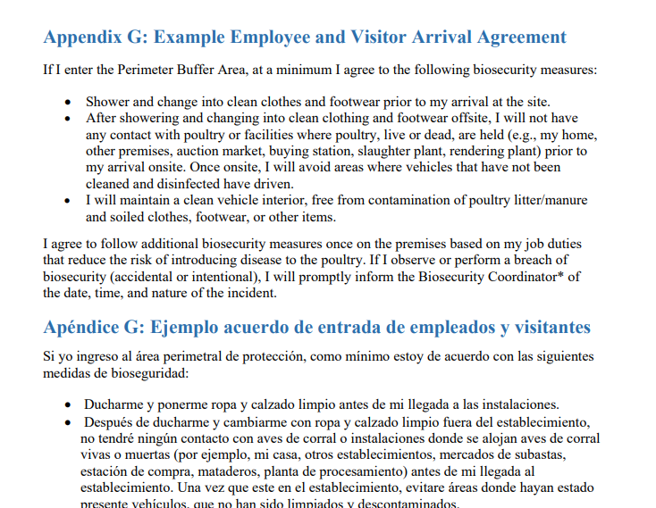
Before Arriving
Ensure clean vehicle interior
Determine need to enter PBA/cross LOS
Shower, wear clean clothing/footwear
Afterwards, do NOT contact poultry before arriving at site
Leave personal items at home
Agree to follow biosecurity protocols
Notes:
It is possible to reduce the potential that you introduce disease, even if you may have been previously contaminated. Before arriving, you should [CLICK] ensure that the inside of your vehicle is clean of all poultry manure or litter and has not become contaminated by soiled clothes, footwear, or other items. [CLICK] You should determine in advance whether you may need to enter the Perimeter Buffer Area, or PBA, which will be explained later in this presentation. [CLICK] If so, it is important that you arrive at the operation having showered and wearing clean clothing and footwear [CLICK] since last contacting poultry, and [CLICK] leave unnecessary personal items, like jewelry, at home. You should also know whether you will need to also cross the Line of Separation, or LOS, which will also be explained later in this presentation. Based on if you need to enter the PBA or cross the LOS, you will need to [CLICK] follow certain biosecurity protocols, and may need to have a signed agreement on file, such as the one shown, indicating that you understand and will follow these instructions.

Slide 14
Designated Parking Area
Vehicles entering should be cleaned and disinfected, even if they look clean
All others park in designated area away from poultry
Pam Zaabel, ISU
Notes:
Vehicles that have been outside of the operation can bring virus in on their surfaces, such as tires or undercarriage, even if they look clean. If the vehicle you are arriving in must enter the operation, it should be [CLICK] cleaned and disinfected. If not, it is important for you to [CLICK] park in a designated area away from poultry and walk to the specified access point. This area should be marked and labeled on a map of the premises.

Slide 15
Entry Logbook
Prepare to record
Contact information
Reason for entry
Date and description of last poultry contact
Individual supervising entry has authority to permit or deny access
Notes:
Prior to entering the Perimeter Buffer Area, even if you are entering within a vehicle, you may need to [CLICK] sign an entry logbook for the operation. [CLICK] Be prepared to record your [CLICK] contact information, [CLICK] reason for entry, and the [CLICK] date and description of last poultry contact. [CLICK] There may be a person supervising the entry logbook, and they will have the authority to permit or deny you access to the operation.

Slide 16
Maintaining Biosecurity
May require change in normal practices
Everyone, every time
Contact Biosecurity Coordinator with questions, concerns
More resources available at poultrybiosecurity.org
Notes:
Maintaining enhanced biosecurity [CLICK] may require changing your normal practices and following some additional steps. This presentation has covered certain biosecurity measures, especially those involving steps you should take before arriving at the operation. The operation’s written site-specific biosecurity plan may hae additional protocols for you to follow; and while all of these steps may seem inconvenient, remember that maintaining biosecurity on the operation is important to protect poultry from being exposed to disease. Remember, the biosecurity plan can only work if [CLICK] EVERYONE on the operation follow it, all of the time. [CLICK] You are encouraged to communicate with the Biosecurity Coordinator if you have questions or concerns, including if you think you or someone else may have accidentally made a mistake related to biosecurity, so that the site’s biosecure status can be restored and the poultry on the site remain healthy. [CLICK] It is also a good idea to frequently refer to biosecurity handouts and signs to remember the important biosecurity procedures. More resources, such as the handout shown here, are available at www.poultrybiosecurity.org.

Slide 17
Congratulations!
Complete the lessons:
Do Not Bring Disease to the Poultry Site
Understanding the Perimeter Buffer Area
Understanding the Line of Separation
Then:
Review the parts of the written site-specific biosecurity plan that apply to your responsibilities
Document your training
Notes:
Congratulations! You, someone who will be working on the poultry operation, have [CLICK] completed the lesson on “Do Not Bring Disease to the Poultry Site”. Next, you can learn about how to prevent the spread of disease once you are on the site, by watching the training videos called [CLICK] “Understanding the Perimeter Buffer Area” and “Understanding the Line of Separation.” The operation’s written site-specific biosecurity plan may have additional protocols for you to follow, so be sure to [CLICK] review the parts of the written plan that apply to your responsibilities, and contact the Biosecurity Coordinator with any questions you may have. [CLICK] Be sure to document all of your training.

Slide 18
Notes:
Development of poultry biosecurity training materials was funded by USDA. This video was written and produced by the Center for Food Security and Public Health at Iowa State University, College of Veterinary Medicine.

