Slide 1
Understanding the Line of Separation
Biosecurity Training for Individuals Working on the Poultry Operation
Notes:
October 2018
Everyone entering the poultry operation plays an essential role in protecting the health of the poultry on a poultry site. By following specific biosecurity steps, employees can minimize the risk of bringing avian influenza or other diseases to the site. One of the most important biosecurity concepts for you to understand is called the Line of Separation.

Slide 2
Learning Goals
Explain how to identify the Line of Separation (LOS) and what its purpose is
Describe how to respect the LOS
Explain biosecurity measures to be taken when entering the LOS
Notes:
By the end of this training, you should be able to [CLICK] explain how to identify the Line of Separation, or LOS, and explain what its purpose is; [CLICK] describe how to respect the LOS; and [CLICK] explain the biosecurity measures that need to be taken when entering the LOS.

Slide 3
Line of Separation
Inner control boundary
Purpose to isolate poultry from potential disease sources
Walls of building/ other structure, obstacles
Control entry of people, vehicles/equipment → reduce risk of disease introduction
Notes:
The Line of Separation, or LOS, is [CLICK] the inner control boundary on the poultry site. [CLICK] The purpose of having a LOS on the poultry site is to isolate poultry from potential disease sources. [CLICK] For indoor-raised poultry, the LOS is usually the walls of the building. For indoor-raised poultry with access to the outdoors, the LOS may be extended from the walls of the building to include the walls of the outdoor pens or porches. For poultry with non-enclosed outdoor access, such as pastured poultry, natural or man-made obstacles which contain the poultry within a designated area may constitute the LOS. [CLICK] By controlling entry of people, and equipment or vehicles as applicable, into the LOS, the risk of introducing disease into the poultry areas will be reduced.

Slide 4
“Last Line of Defense”
Notes:
The LOS is sometimes called the “last line of defense” for protecting the birds housed on the site. It can be helpful to think of the LOS as [CLICK] the walls of a castle. The moat is the “first line of defense”-- on the poultry site, this is the Perimeter Buffer Area, or PBA, which is covered in another video. Once people, vehicles, or other items enter the PBA, or cross the moat, the last protective barrier between the poultry and the outside world is the LOS, or the walls of the castle. The door to the castle is the LOS access point, controlled by the operation. The operation decides when to open the door and let in a person or other item after appropriate biosecurity measures have been followed.

Slide 5
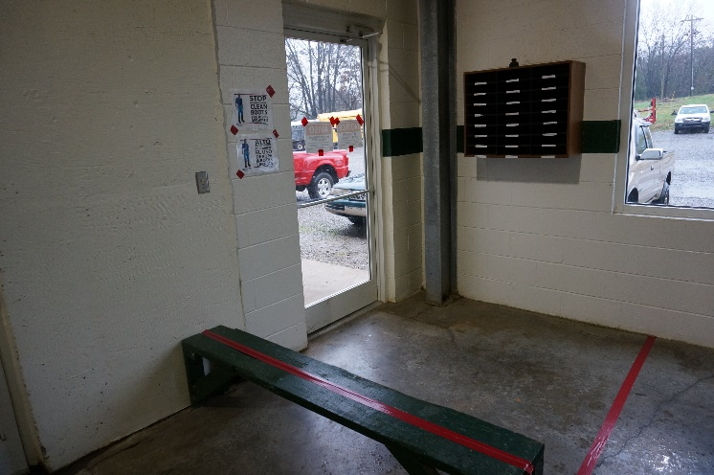
Identifying the LOS
Read the Biosecurity Plan
Look for barriers, signage
Ask the Biosecurity Coordinator
Pam Zaabel, ISU
Notes:
While the edge of the LOS on a poultry operation is typically the walls of the building, each farm is different, and there may be situations where the boundary of the LOS is not as clear. The best way to determine where the LOS is located is by [CLICK] reading the site-specific biosecurity plan, which may include a labeled map of the site. A site may have as many Lines of Separation as there are buildings, or buildings connected by a hallway may all be within one Line of Separation. In places where the boundary of the LOS is not as clear, such as entries to the building, the LOS may be delineated by [CLICK] barriers, such as a bench, signage, or [CLICK] visible markings such as rope or a paint or tape line on the walls or floor. Sometimes, the LOS might be a door, or the entrance to a shower stall. Finally, you may [CLICK] ask the Biosecurity Coordinator for details on the location of the LOS, since he or she has played an important role in deciding where the LOS is located.

Slide 6
Example LOS
Notes:
This example site demonstrates the concept of the Line of Separation (LOS). In this example, personnel enter the Perimeter Buffer Area, or PBA, through an Access Point. The PBA is covered in another video. This access point then leads to a Danish Entry System, which on this site, is the only way to cross the LOS, shown here as a red line, and access the poultry houses. The Danish Entry system will be described later in this presentation. The LOS surrounds all poultry houses, which are connected to one another by a walkway and egg belt. Once an individual crosses the LOS using the Danish Entry System, he or she can access all of the poultry houses without needing to perform additional biosecurity steps.

Slide 7
Example LOS
Notes:
Another example of a LOS is shown in this aerial photo of a poultry site. In this example, the line of separation is outlined in red. Here, individuals can enter the LOS through the access point, labeled in orange, at the bottom of the image, and use the connected walkways to access all houses without following another biosecure entry procedure. If they need to exit a house, they can re-cross the LOS after following a biosecure entry procedure, at a Access Point for an individual building, as can be seen by the orange lines in the center of the site shown in this image. There are also access points at the opposite end of each building; these are meant to be used for removal of dead birds, as indicated by the blue arrows labeled carcass removal pathway.

Slide 8
Respecting the LOS
Determine in advance
Your need to cross the LOS
LOS boundaries
Access Point locations
Crossing requires additional biosecurity steps
Certain movements may be different
Check biosecurity plan
Notes:
Sometimes, individuals entering the site will ONLY need to enter the PBA, and will not have to cross the LOS. [CLICK] In most cases, you will be able to determine in advance whether you will need to cross the LOS or not. Regardless of if you plan on crossing the LOS, before entering the site, make sure you know [CLICK] where the boundaries of the LOS are, [CLICK] and where access points are located. [CLICK] Recognize that when people, vehicles, equipment, or other items cross the LOS at the entry point, specific biosecurity steps need to be followed. [CLICK] Occasionally, for certain movements, like manure or litter removal or loading or unloading of poultry, the boundaries of the Line of Separation may change. If you are involved in these types of movements, it is especially important to know in advance whether you will follow the normal biosecurity steps in order to enter the perimeter buffer area and cross the LOS, or if these steps– and perhaps the location of the LOS– will temporarily change to accommodate these movements. [CLICK] You can always check the site’s biosecurity plan, or ask the biosecurity coordinator, if you are unsure of how to respect the Line of Separation while you are on the poultry site.

Slide 9
Crossing the LOS- Personnel
“Biosecure Entry Procedure”
May vary from steps to enter PBA
Steps may be different if
Site-dedicated
Non-farm personnel
Recent poultry contact
Do not bring contamination from one side to the other
Notes:
The steps that need to be taken to cross the LOS are referred to as [CLICK] a biosecure entry procedure. If you are crossing the LOS, you should already have followed a biosecure entry procedure for entering the Perimeter Buffer Area, or PBA. The PBA is covered in another video. [CLICK] While the PBA biosecure entry procedure and the LOS biosecure entry procedure on a site may sometimes be the same, often, they are different- just like procedures may vary between sites. [CLICK] In addition, the steps taken to cross the LOS may be different based on if you are [CLICK] a site-dedicated employee, or [CLICK] if you are non-farm personnel. Steps may also vary [CLICK] if you have had recent contact with other poultry or avian species. [CLICK] When crossing the LOS, it is very important to not bring contamination from clothing, footwear, or exposed skin from one side of the LOS to the other.

Slide 10
Biosecure Entry Procedure
Notes:
One example of a Biosecure Entry Procedure used for crossing the LOS is called a Danish Entry. The image shown here is an example of this type of Biosecure Entry Procedure. In this example, a barrier, the bench, and a red dotted line, clearly show the boundary of the LOS. Personnel enter the area through the door on the right side of the image, remove their footwear and outer clothing, and sit down on the bench facing to the right. The individual then applies hand sanitizer and swings their legs over the bench to get into the position shown here. At this time, they put on their site-dedicated clean clothing and footwear, wash their hands, put on gloves, and step into the footbath before going through the door on the left side of the image to gain barn access. Depending on the individual’s job duties, the biosecurity plan may require them to follow all of these steps, or just some of them. This is just one example of a biosecure entry procedure. The site you are working on may have different or additional steps, such as showering.

Slide 11
Crossing the LOS- Supplies
Best to leave off-site
May cross if biosecurity steps followed
See biosecurity plan, coordinator
Pam Zaabel, ISU
Notes:
While it is [CLICK] best to leave personal items, and have deliveries made to, areas outside of the site, sometimes it is necessary for these items to cross the Line of Separation. In these cases, it [CLICK] may be acceptable for certain items to cross if specific biosecurity steps are followed. For example, this could include using a pass-through disinfection window for lunches, keeping electronic devices in sealed plastic bags or disinfectable outer cases, which are then disinfected, or [CLICK] double boxing tools or supplies, so that the person on the outside of the LOS can open the outer box and empties the inner box to a person on the poultry side of the LOS, like shown in this photo. For more guidance on what items are allowed to cross the LOS, and how, [CLICK] see the site’s biosecurity plan, or ask the biosecurity coordinator.

Slide 12
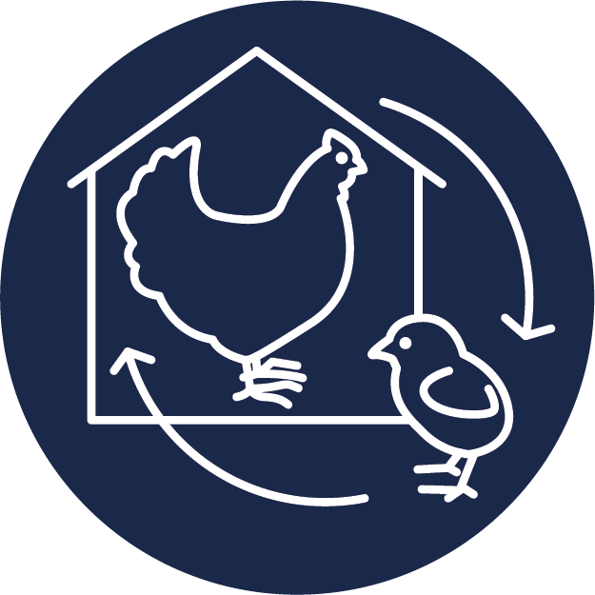
Crossing the LOS- Poultry
Use LOS Access Point
May be separate from people access point
Special procedures may be needed
Before starting
Ensure enough workers present
Know what to do with used containers, etc.
Notes:
Movement of poultry across the LOS [CLICK] should be done through an established LOS Access Point. In some facilities, the people LOS Access Point and the poultry LOS Access Point are the same. [CLICK] For others, especially shower-in/shower-out houses, the LOS Access Point for poultry is separate from the LOS Access Point for people. [CLICK] Sometimes, poultry movement may require special procedures that are different from how things normally cross the LOS. This might include one person on each side of the LOS passing containers across the LOS, or even temporarily modifying where the LOS is during loading or unloading. [CLICK] It is a good idea to check with the biosecurity coordinator, and section on replacement poultry in the site’s biosecurity plan, before loading or unloading birds onto or off of the site. When moving poultry across the line of separation, make sure [CLICK] you have enough people to be able to follow all of the required protocols, and [CLICK] that you know what to do with items such as empty containers, before getting started.

Slide 13
Biosecure Exit Procedure
Remove site-dedicated or disposable clothing, boots
C&D footwear, wash hands
Soiled clothing left on operation or sealed in bag/tote
Renee Dewell, ISU
Notes:
It is also important to prevent visible contamination on clothing, footwear, and exposed skin from leaving the operation and being transferred to other locations with susceptible poultry. Like when leaving the PBA, in most cases, the Biosecure Entry Procedure is followed in reverse when crossing back to the outside of the LOS. This usually involves [CLICK] removing any site-dedicated or disposable clothing or footwear, [CLICK] cleaning and disinfecting footwear that is leaving the site, and washing your hands. Additional steps may also be required. [CLICK] Any soiled clothing can be left on the operation to be laundered or disposed of. If you need to bring it with you, store it in a garbage bag or tote until it can be laundered. Make sure that you do not bring contamination from one side of the LOS to the other when you are leaving.

Slide 14
Mortalities, Manure/Litter
Mortalities
One way, direct movement
Report if needed
Manure and litter
SOPs
May involve modified LOS
Notes:
Like when people perform a biosecure exit procedure, you should maintain biosecurity when other items cross back to the outside of the Line of Separation. Two examples of product leaving the LOS are [CLICK] mortalities, and [CLICK] manure or litter. [CLICK] Movement of mortalities should be one-way, so that once a dead bird or birds exit the building or poultry raising area, they do not re-enter, and personnel involved in mortality removal should take the most direct route possible to the disposal area. It is recommended that mortality removal be done at the end of the work day, so that personnel do not need to cross back to the bird side of the LOS after handling dead poultry. If you do need to cross back onto the bird side of the LOS, you should follow all required biosecurity steps as if you were crossing the LOS for the first time. If you are involved in mortality management or disposal, and [CLICK] notice that there seems to be an unexpected increase in sick or dying birds, remember that it is important to tell someone, in case it is an undetected disease outbreak. Similar biosecurity precautions should be taken for poultry manure and litter that is leaving the site. [CLICK] For some procedures, there may be Standard Operating Procedures, or SOPs, that you can follow. Like for poultry movement, movement of litter and manure [CLICK] may require special procedures that are different from how things normally exit the LOS, potentially including a modified LOS.

Slide 15
Congratulations!
Complete the lessons:
Understanding the Line of Separation
Understanding the Perimeter Buffer Area
Do Not Bring Disease to the Poultry Site
Then:
Review the parts of the written site-specific biosecurity plan that apply to your responsibilities
Document your training
Notes:
Congratulations! You, someone who will be working on the poultry operation, have [CLICK] completed the lesson on “Understanding the Line of Separation”. If you have not already, watching the training videos called [CLICK] “Understanding the Perimeter Buffer Area” and [CLICK] “Do Not Bring Disease to the Poultry Site” can help you understand how to avoid bringing disease to the site. The operation’s written site-specific biosecurity plan may have additional protocols for you to follow, so be sure to [CLICK] review the parts of the written plan that apply to your responsibilities, and contact the Biosecurity Coordinator with any questions you may have. [CLICK] Be sure to document all of your training.

Slide 16
Notes:
Development of poultry biosecurity training materials was funded by USDA. [CLICK] This video was written and produced by the Center for Food Security and Public Health at Iowa State University, College of Veterinary Medicine.

