Slide 1
Implementation of Poultry Biosecurity
Biosecurity Training for Biosecurity Coordinators, Designees, and On-Site Managers
Notes:
October 2018
This presentation describes biosecurity measures that are important for protecting against poultry diseases, especially avian influenza, which requires heightened precautions over biosecurity plans for endemic diseases. The biosecurity recommendations outlined in this presentation are based on the known exposure routes for avian influenza. Implementing and maintaining biosecurity is a great responsibility. Thank you for stepping up!

Slide 2
Why Biosecurity is Important
Disease outbreaks can have devastating effects
It is the responsibility of EVERYONE involved in raising a flock to keep flocks from becoming infected
Biosecurity is structural and operational
Diseases will test effectiveness of operational biosecurity
Individual awareness and behavior
Notes:
An outbreak of a disease agent—especially avian influenza—can have devastating effects on animal health and international trade. [CLICK] To prevent an AI outbreak, it is the responsibility of everyone involved in raising a flock to keep poultry flocks from becoming infected by focusing on biosecurity they can control on their premises. [CLICK] Biosecurity approaches are both structural and operational. Structural biosecurity is built into the physical construction and maintenance of a facility. Operational biosecurity involves management practices designed to prevent the introduction and spread of disease agents onto or off of an animal production premises. [CLICK] Poultry diseases, especially High Pathogenicity AI (HPAI) will test the effectiveness of operational biosecurity, because successful implementation of these practices depends on [CLICK] the awareness level and behavior of individuals on the operation.

Slide 3
Responsibilities
Write
Train
Implement
Notes:
Biosecurity Coordinators are responsible for [CLICK] writing a biosecurity plan specific to the operation, with the assistance of a veterinarian, and [CLICK] implementing or supporting the training of all employees and other personnel who enter the site. The on-site manager, who may be the same or different than the Biosecurity Coordinator, and any designees, are responsible for ensuring that the biosecurity practices for that location are followed on a daily basis. [CLICK] Everyone working on the poultry operation is responsible for implementing the plan on that operation.

Slide 4
Site-Specific Written Biosecurity Plan
Define scope
Describe facilities included
Include PIN
Request from State Animal Health Official
Separate plans for off-site premises
Includes labeled premises map
Provide copies, access
Notes:
One of the Biosecurity Coordinator’s most important duties is developing the site-specific written biosecurity plan. The plan should [CLICK] define the scope of your operation, clearly describing all types of poultry and other species, and [CLICK] should describe poultry houses or other areas where the birds are housed or raised, and include the [CLICK] Premises Identification Number, or PIN, for each. [CLICK] If you do not have a PIN for your site, you may request one from the office of your State Animal Health Official. [CLICK] It is best to consider each farm with poultry at non-adjacent locations or multiple locations that must be accessed via a public road as a separate site, with a separate Premises Identification Number (PIN), and therefore, a separate biosecurity plan. However, sites under common ownership and/or management, such as production sites within a complex, or complexes managed by the same company, may follow a common biosecurity program, and thus these site-specific plans may have significant overlap. [CLICK] Your plan should include a labeled map of the premises. [CLICK] You should also ensure that all individuals entering the operation frequently have access to a copy of the biosecurity plan. It is important to review the plan at least annually and whenever the operation goes through a change that affects biosecurity.

Slide 5
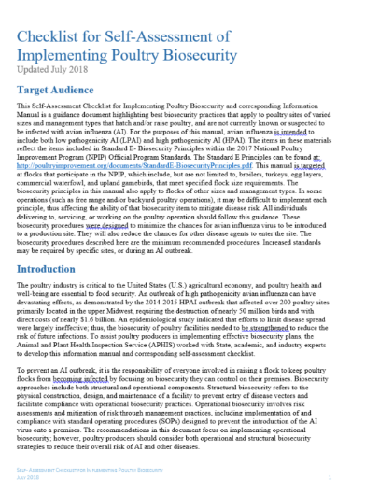
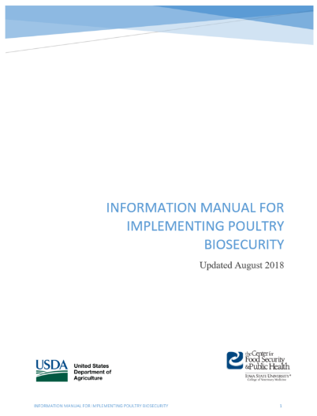
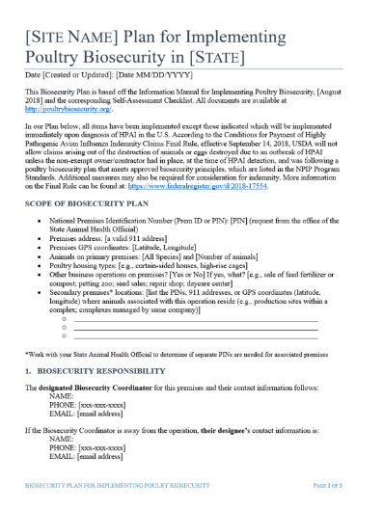
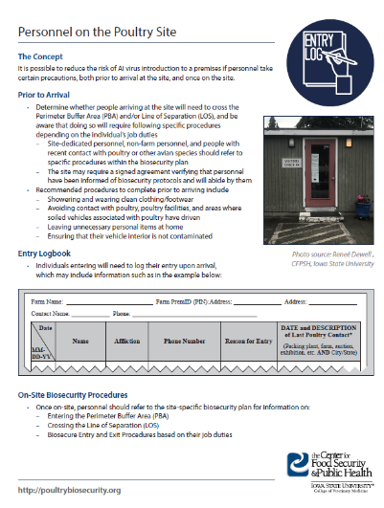
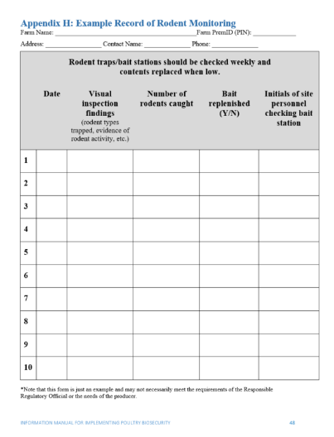
Resources for Creating the Written Plan
Checklist
Information Manual
Customizable templates
Factsheets
Example logs and forms
http://poultrybiosecurity.org/
Notes:
www.poultrybiosecurity.org includes many tools to assist in writing your site-specific biosecurity plan. [CLICK] A Checklist for Self-Assessment of Implementing Poultry Biosecurity highlights key biosecurity practices [CLICK] and a corresponding Informational Manual provides in-depth guidance on planning and implementing each checklist item. [CLICK] Customizable templates help you to create a comprehensive biosecurity plan for your site. [CLICK] Factsheets for employees or visitors to your operation are available [CLICK] as well as example logs that may be used to track movements and forms for other biosecurity records. The remainder of this presentation highlights aspects of biosecurity that are particularly important to consider when writing, training on, and implementing your site’s biosecurity plan.

Slide 6
Training—Essential Personnel
Premises-wide/company-wide AND farm site-specific procedures
Importance of biosecurity
Non-compliance
Requirements within biosecurity plan
Delivered annually
Documented
Implementing Poultry Biosecurity
Notes:
It is important for both the Biosecurity Coordinator, designees, on-site managers, and other essential personnel, such as managers and caretakers, who are working on the operation to be familiar with the biosecurity plan, including [CLICK] procedures for the entire premises or company as well as specific farm sites. [CLICK] It is important for these personnel to understand the importance of biosecurity, and [CLICK] to understand the reporting process for, and consequences of, non-compliance. [CLICK] You should include what training is required in order to enter the operation, in the site’s written biosecurity plan. [CLICK] Training must be delivered at least once per calendar year, [CLICK] and this training should be documented. [CLICK] This training video satisfies a portion of the training that essential personnel could complete.

Slide 7
Training—All Who Enter
How to contact the Biosecurity Coordinator
How to Respect the PBA and LOS
Additional measures for specific job duties
Do Not Bring Disease to the Poultry Site
Understanding the Perimeter Buffer Area
Understanding the Line of Separation
http://poultrybiosecurity.org/
Notes:
Anyone entering the operation, such as drivers, delivery and service personnel, veterinarians, livestock transporters, and visitors must also be aware of certain biosecurity expectations and protocols. The biosecurity coordinator, or on-site designee, is responsible for communicating this information upon arrival and before entering the operation. All entering the operation must understand a few key points: [CLICK] how to contact the biosecurity coordinator, [CLICK] how to respect the Perimeter Buffer Area, or PBA, and the Line of Separation, or LOS, and how to enter the PBA or cross the LOS if required, [CLICK] and how to perform biosecurity measures that pertain to their specific job duties. Three training modules that all individuals should complete include [CLICK] “Do Not Bring Disease to the Poultry Site,” [CLICK] “Understanding the Perimeter Buffer Area,” and [CLICK] “Understanding the Line of Separation.” [CLICK] These videos are available on the poultry biosecurity website.

Slide 8
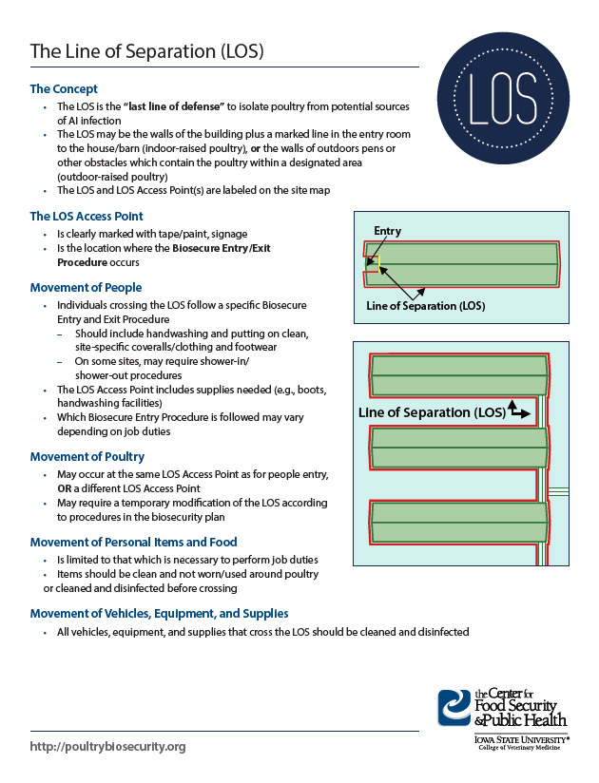
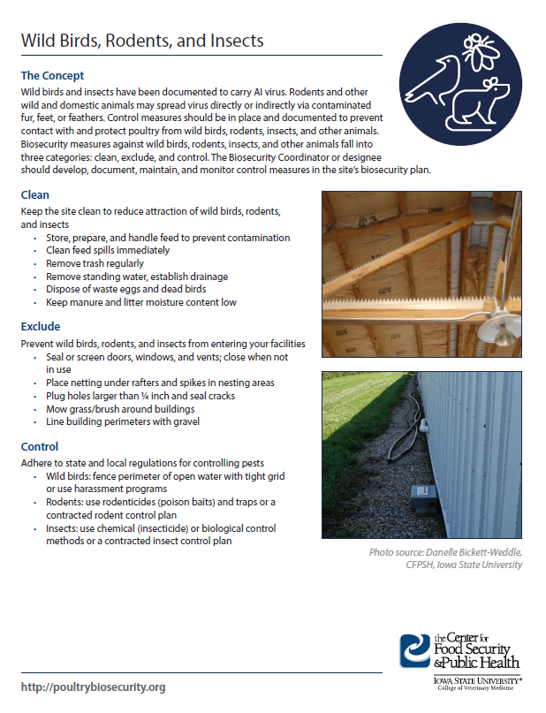
Additional Training Tools
Handouts
Perimeter Buffer Area
Line of Separation
Biosecure Entry Procedure
Personnel
Wild Birds, Rodents, Insects
Vehicles and Equipment
Mortality Management
Manure, Litter Management
Signage
http://poultrybiosecurity.org/
Notes:
[CLICK] Handouts designed for employees, visitors, and others individuals who may be entering the site are available on [CLICK] the Perimeter Buffer Area; [CLICK] Line of Separation; [CLICK] Biosecure Entry Procedure; [CLICK] Personnel; [CLICK] Wild Birds, Rodents and Insects; [CLICK] Vehicles and Equipment; [CLICK] Mortality Management; and [CLICK] Manure and Litter Management. [CLICK] Additional signage is also available to post on the operation to indicate the boundaries of the Line of Separation, Biosecure Entry Points, and Biosecure Entry Procedure. [CLICK] All of these materials can be accessed on the poultry biosecurity website. Remember to document all training completed by individuals working on your operation.

Slide 9
Perimeter Buffer Area (PBA) and Line of Separation (LOS)
More information can be found in the biosecurity checklist, information manual, and templates at www.poultrybiosecurity.org
Notes:
The Perimeter Buffer Area, or PBA, and Line of Separation, or LOS, are very important parts of your biosecurity plan. The PBA is the “first line of defense” to protect the poultry housed within its perimeter, and is a functional zone surrounding the poultry houses or poultry raising area that separates them from areas unrelated to poultry production on that site and/or adjoining properties. The LOS is the “last line of defense” to isolate poultry from potential sources of disease, and may be the walls of the building or other obstacles which contain the poultry within a designated area. Both the PBA and LOS have specific access points, where people, vehicles, and equipment entering must follow specific biosecurity steps. This slide shows an aerial view of a poultry farm. The blue line indicates the PBA, and the red line indicates the LOS. More information can be found by viewing the training videos called, “Understanding the Perimeter Buffer Area” and “Understanding the Line of Separation,” as well as in the biosecurity checklist, information manual, and templates at www.poultrybiosecurity.org.

Slide 10
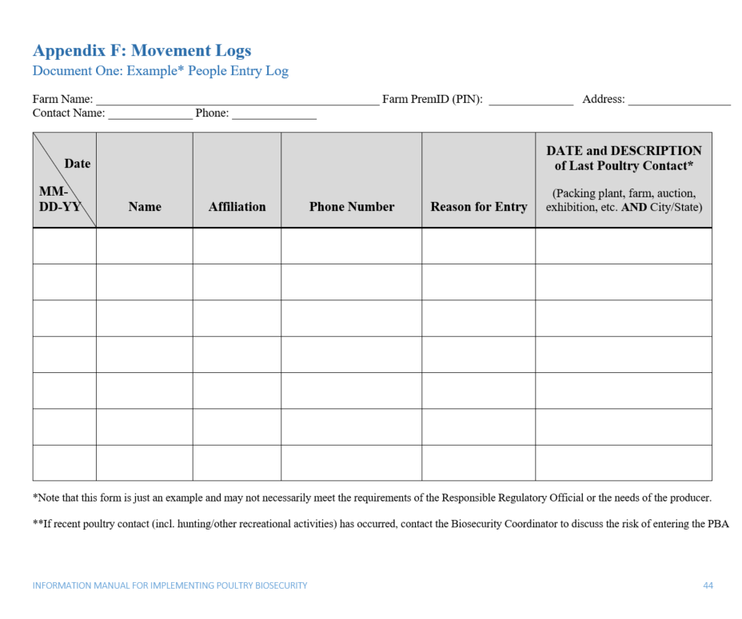
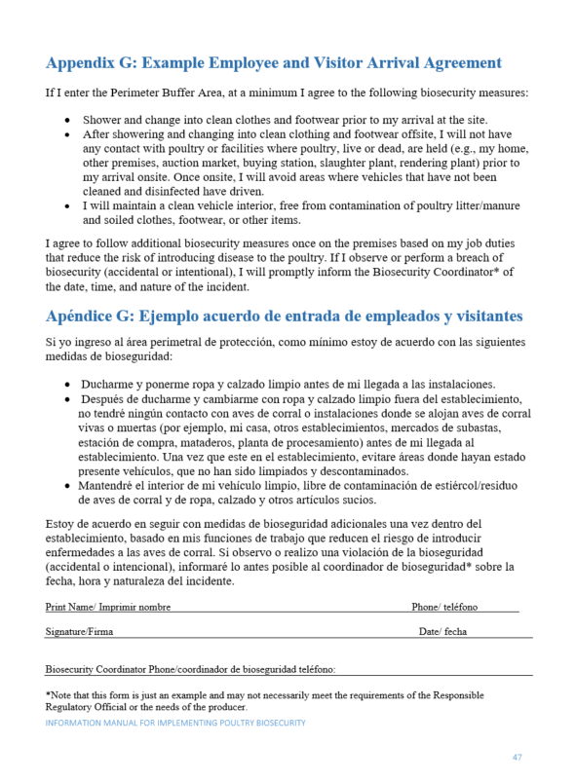
Personnel
Take specific precautions prior to arrival, and once on-site
Determine need to enter PBA and/or cross LOS
Personnel entering in vehicles
Follow biosecure entry, exit procedures
Complete documentation
Visitor arrival agreement
People entry log
www.poultrybiosecurity.org
Notes:
It is possible to reduce the risk of disease introduction to a premises if personnel take [CLICK] certain precautions, both prior to arrival at the site, and once on the site. [CLICK] Determine whether people arriving at the site will need to enter the Perimeter Buffer Area (PBA) and/or cross the Line of Separation (LOS), and develop specific biosecure entry and exit procedures for each. [CLICK] Special accommodations for personnel needing to enter the PBA within a vehicle should also be developed. Biosecurity procedures may vary depending on the individual’s job duties, and [CLICK] all biosecure entry and exit procedures should be written into the site’s biosecurity plan. It is also important to [CLICK] keep records of the biosecurity practices in place for personnel, which may include [CLICK] a signed agreement verifying that visitors and other personnel have been informed of biosecurity protocols and will abide by them, and a [CLICK] people entry log to help you keep track of individuals entering the site. [CLICK] These materials are available on the poultry biosecurity website.

Slide 11
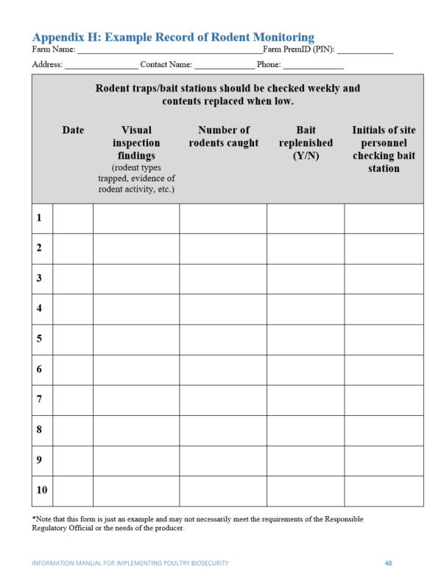
Wild Birds, Rodents, and Insects
May spread virus directly or indirectly
Clean, exclude, control
Documented, monitored plans
Company-developed or contracted
Review during periods of heightened risk
Jack Hamersky, ISU
Notes:
Poultry operations should have control measures to prevent contact with and protect poultry from wild birds, their feces and their feathers as appropriate to the production system. Rodents, insects, and other wild and domestic animals may also spread virus [CLICK] directly or indirectly. The biosecurity plan should include measures to [CLICK] keep the site clean to reduce attraction of wild birds, rodents, and insects; exclude wild birds, rodents, and insects from entering your facilities, and establish control programs to manage pests on the site. [CLICK] Procedures should be documented in the site’s biosecurity plan and written records should be maintained and monitored. [CLICK] Control programs may be designed internally, or may be contracted out to a professional rodent or insect control company. All state and local regulations for pest control must be followed. [CLICK] It is important to reassess procedures during periods of heightened disease risk, such as during an avian influenza outbreak, to determine if adjustments need to be made. Further information may be found in the biosecurity checklist, information manual, and templates at www.poultrybiosecurity.org.

Slide 12
Vehicles and Equipment
Vehicles do not enter PBA unless necessary
Designated parking area
Site-dedicated vehicles
Cleaning and Disinfection
Logbooks
Restrict shared equipment
Notes:
Vehicles and equipment used on poultry production sites can serve as a means for disease spread, and public roadways may be contaminated with AI virus. Managing movement of vehicles and equipment can reduce the risk of AI virus introduction to a premises. [CLICK] Vehicles and equipment should be prohibited from entering the PBA unless necessary, and a [CLICK] designated parking area should be used for employee, visitor, and serviceperson vehicles. [CLICK] Individuals should walk or use designated site-dedicated farm vehicles to move about the site or haul equipment, supplies, or treatment materials to the poultry houses once within the PBA. [CLICK] All vehicles and equipment entering the PBA should only do so through a dedicated access point, where they should be cleaned and disinfected. [CLICK] All records of vehicle and equipment movements by date and time onto the site should be maintained on-site and made available to Responsible Regulatory Officials if needed for a trace-back or trace-forward investigation. Finally, [CLICK] restrict shared equipment, as sharing equipment between poultry sites presents a risk for virus spread.

Slide 13
Cleaning and Disinfection (C&D)
C&D Station or heat treatment
Operators trained on PPE, C&D
Runoff managed
Contingency plans developed
Danelle Bickett-Weddle, ISU
Notes:
Cleaning and disinfection, or C&D, may occur via thorough cleaning, application of a disinfectant effective against the Influenza A virus, and allowing adequate contact time for the disinfectant to kill the virus, which is best accomplished at a [CLICK] cleaning and disinfection station on-site. C&D may also occur by heating equipment for a time and temperature that inactivates the AI virus. [CLICK] The individuals that operate the C&D station should be trained to understand the principles of cleaning and disinfection and should be able to select and use appropriate Personal Protective Equipment, or PPE. [CLICK] It is also important to manage runoff from the C&D station [CLICK] and to have contingency plans for cleaning and disinfection of vehicles and equipment in case of inclement weather such as freezing temperatures.

Slide 14
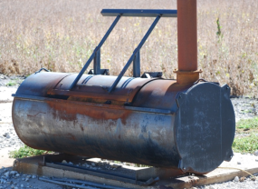
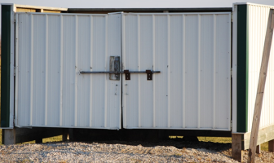
Morbidity, Mortality
Plans for
Seeking
Removing
Disposal
Consider LOS, PBA
Records
Reporting
Pam Zaabel, ISU
Notes:
Develop a plan for disposal of all deceased birds. The plan should include the process for [CLICK] seeking and [CLICK] removing dead poultry, frequency of removal, [CLICK] storage and disposal of carcasses, and pest control around mortality storage and disposal areas. Options for disposal may include composting, incineration, burial, or rendering; each comes with its own challenges related to disease prevention. Methods and options may vary locally or by state and should comply with all local, state, and federal regulations. [CLICK] The biosecurity plan should describe how mortalities, as well as people, vehicles, and equipment involved in mortality management, cross the LOS and exit the PBA. It is extremely important to [CLICK] recognize elevated morbidity and mortality as early as possible. Expected mortality numbers vary by bird type, flock age, and even by individual flock. The Biosecurity Coordinator should include in the site-specific biosecurity plan the mortality rate that constitutes elevated morbidity and mortality, taking into account the variables of flock age and bird type, and ensure that individuals working on the operation understand appropriate measures for monitoring and reporting elevated morbidity and mortality. [CLICK] It is important to report elevated morbidity and mortality to Responsible Regulatory Officials to implement effective disease control strategies. The reporting procedure should clearly describe the appropriate chain of communication within the poultry company and should include the Responsible Regulatory Officials.

Slide 15
Manure and Litter Management
Strategies vary, depend on
Type, number of birds
Type of housing system
Site characteristics, weather
SOPs for each site
Collection, transportation, storage, use
Personnel, Equipment entry
Modifications to LOS, PBA
C&D between flocks
More information can be found in the biosecurity checklist, information manual, and templates at www.poultrybiosecurity.org
Notes:
Avian influenza virus has been shown to survive in poultry manure and litter for long periods of time, especially in cold weather. [CLICK] There are numerous manure and litter management strategies that may be used, and which of these is implemented depends on [CLICK] the type and number of birds and [CLICK] type of housing system. Manure and management strategies also depend on [CLICK] physical characteristics of the site and weather. The Biosecurity Coordinator should develop [CLICK] site-specific SOPs for entry and activities related to personnel and equipment involved in manure/litter management activities. [CLICK] The site-specific plan should include the types and amounts of manure or litter expected over a given time frame and procedures to collect, transport, store, and use the manure. [CLICK] All personnel, vehicles and equipment entering the PBA should only do so through a PBA Access Point. However, some operations may choose to make [CLICK] temporary modifications to the PBA and/or LOS for manure and litter movement. This increases risk of disease introduction and must be done under careful supervision. A site-specific biosecure entry procedure should be defined for procedures that require a modified PBA or LOS. Once manure/litter is completely removed from the poultry house, the poultry house should undergo [CLICK] complete cleaning and disinfection (using chemical disinfectants or heat) before the introduction of new birds. [CLICK] Additional guidance on manure and litter management can be found in the biosecurity checklist, information manual, and templates on the poultry biosecurity website.

Slide 16
Replacement Poultry
Source from high health status flocks
NPIP guidelines
Review biosecurity protocols
Biosecure entry procedures
Personnel, equipment, containers
Live bird loading/ unloading procedures
Modified PBA/LOS Access Points
More information can be found on www.poultrybiosecurity.org or www.poultryimprovement.org
Notes:
Replacement poultry should be [CLICK] sourced from poultry flocks of known high health status that are regularly monitored for poultry pathogens according to the [CLICK] NPIP guidelines, such as AI Clean or H5/H7 AI Clean. [CLICK] More information on these guidelines can be found in the Information Manual for Implementing Poultry Biosecurity, or on the NPIP website. [CLICK] Biosecurity Coordinators may also wish to verify that the source site’s biosecurity plan aligns with yours by reviewing their biosecurity protocols. [CLICK] Biosecure entry procedures should be established and followed by all personnel, equipment, and containers entering the site. [CLICK] Loading and unloading poultry presents an increased risk of disease introduction since open trucks containing live birds cannot be effectively cleaned and disinfected when crossing the PBA without harming the birds. These procedures should be carefully designed and monitored by the Biosecurity Coordinator or designee in order to minimize risk. [CLICK] Like for poultry manure and litter management, some operations may choose to temporarily modify the LOS or PBA Access Points for loading or unloading.

Slide 17
Water Supplies
Drinking, cooling, washing
Clean, free of disease agents
Contained supply preferred
Testing, treatment, risk analysis
Follow cleaning with disinfection
USDA
Notes:
[CLICK] Many wild waterfowl may carry AI virus and pass the virus in their feces, potentially contaminating surface water such as lakes, ponds, rivers, and streams. Water crosses the LOS daily and could pose a risk for transmission of AI virus. [CLICK] The Biosecurity Coordinator should take steps to ensure that any water used within the poultry site for [CLICK] drinking, cooling, or washing is [CLICK] clean and free of disease agents. [CLICK] Water sourced from a contained supply such as a well or municipal system is recommended. [CLICK] Water should be testing and treated as needed to eliminate any potential contamination with disease agents, and these processes should be described in the biosecurity plan. [CLICK] If surface water is used for cleaning, subsequent disinfection should be employed to prevent disease transmission. Any water not treated should provide evidence of a risk assessment and mitigation processes used.

Slide 18
Feed and Replacement Litter
Manage finished feed, feed ingredients, bedding, litter
Delivery, storage, maintenance
Daily spill check
Consider PBA, Access Points
Modifications during harvest
Limit contamination by wild birds, rodents, insects, other animals
Notes:
[CLICK] Feed, feed ingredients, bedding, and replacement litter can be contaminated if exposed to wild waterfowl or other birds, insects or rodents that might be carrying AI virus. [CLICK] These items should be delivered, stored and maintained in a manner that limits exposure to and contamination by wild birds, rodents, insects, and other animals. [CLICK] There should be a daily feed spill check, with immediate cleanup if necessary. [CLICK] It is important to consider the entry and movement of feed delivery vehicles and the feed they carry when determining the best location for the PBA and Access Points. [CLICK] It may be necessary to temporarily modify the PBA if there is extensive unloading of grains during harvest. [CLICK] The Biosecurity Coordinator should include in the site-specific biosecurity plan measures to limit exposure of feed, feed ingredients and replacement litter to contamination by wild birds, rodents, insects, and other animals. This may include written protocols, log sheets, guidance for contractors, and so on.

Slide 19
Auditing
Requirement based on flock sizes
Based on
Biosecurity plan’s training materials
Documentation of implementing principles
Corrective actions
Annual review
Check audits for those failing initial document audit
Notes:
Auditing of the biosecurity principles [CLICK] is based on flock size as outlined in the Code of Federal Regulations. Audits will be conducted based on the judgement of the Official State Agency responsible, or at least once every two years. Each audit requires [CLICK] the biosecurity plan’s training materials, [CLICK] documentation of implementation of the NPIP Biosecurity Principles, [CLICK] corrective actions taken, and [CLICK] the Biosecurity Coordinator’s annual review to be audited for completeness and compliance with the NPIP Biosecurity Principles. [CLICK] Those participants who failed the initial document audit conducted may elect to have a check audit performed by a team appointed by National NPIP Office.

Slide 20
Congratulations!
Complete the lessons:
Implementation of Poultry Biosecurity
Do Not Bring Disease to the Poultry Site
Understanding the Perimeter Buffer Area
Understanding the Line of Separation
Then:
Implement your written site-specific enhanced biosecurity plan on your operation
Oversee and document training of all essential personnel
Notes:
Congratulations! You, the biosecurity coordinator, designee, or on-site manager, have [CLICK] completed the lesson on “Implementation of Poultry Biosecurity.” If you have not already, you should also [CLICK] review the lesson called, “Do Not Bring Disease to the Poultry Site,” which covers key biosecurity measures, especially those that individuals working on the operation may need to take before arrival, and important measures to respect the LOS. Additionally, [CLICK] review the lessons called “Understanding the Perimeter Buffer Area” and [CLICK] “Understanding the Line of Separation.” [CLICK] Then it is time to implement your written site-specific enhanced biosecurity plan on your operation, [CLICK] ensure training of all essential personnel, and document this training.

Slide 21
Notes:
Development of poultry biosecurity training materials was funded by USDA. This video was written and produced by the Center for Food Security and Public Health at Iowa State University, College of Veterinary Medicine.

